Slide 1
Chapter 17 – Regression Based Forecasting
Data Mining for Business Analytics in Python
Shmueli, Bruce, Gedeck & Patel

Slide 2
Main ideas
Fit linear trend, time as predictor
Modify & use also for non-linear trends
Exponential
Polynomial
Can also capture seasonality

Slide 3
Import needed functionality
import math
import numpy as np
import pandas as pd
import matplotlib.pylab as plt
import statsmodels.formula.api as sm
from statsmodels.tsa import tsatools, stattools
from statsmodels.tsa.arima_model import ARIMA
from statsmodels.graphics import tsaplots

Slide 4
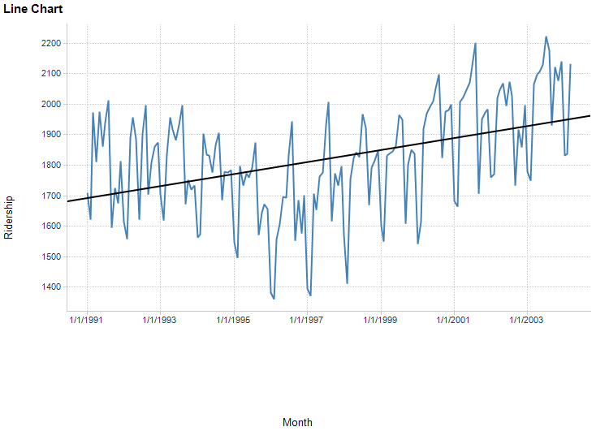
Linear fit to Amtrak ridership data (Doesn’t fit too well – more later)

Slide 5
The regression model
Ridership Y is a function of time (t) and noise (error = e)
Y_{i} = B₀ + B₁*t + e
Thus we model 3 of the 4 components:
Level (B₀)
Trend* (B₁)
Noise (e)
*Our trend model is linear, which we can see from the graph is not a good fit (more later)

Slide 6
Coding the regression model
# load data and convert to time series
Amtrak_df = pd.read_csv('Amtrak.csv')
Amtrak_df['Date'] = pd.to_datetime(Amtrak_df.Month, format='%d/%m/%Y')
ridership_ts = pd.Series(Amtrak_df.Ridership.values, index=Amtrak_df.Date)
# fit a linear trend model to the time series
ridership_df = tsatools.add_trend(ridership_ts, trend='ct')
ridership_lm = sm.ols(formula='Ridership ~ trend', data=ridership_df).fit()
# plot the time series
ax = ridership_ts.plot()
ax.set_xlabel('Time')
ax.set_ylabel('Ridership (in 000s)')
ax.set_ylim(1300, 2300)
ridership_lm.predict(ridership_df).plot(ax=ax)
plt.show()

Slide 7
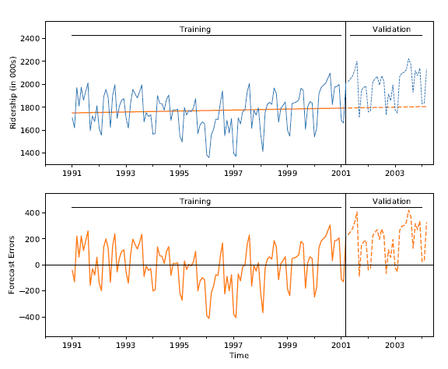
Applying the model to partitioned data
# fit linear model using training set and predict on validation set
ridership_lm = sm.ols(formula='Ridership ~ trend', data=train_df).fit()
predict_df = ridership_lm.predict(valid_df)
Ridership
Trend based on training data underestimates validation period
Forecast Errors

Slide 8
Code for the previous plots
def singleGraphLayout(ax, ylim, train_df, valid_df):
ax.set_xlim('1990', '2004-6')
ax.set_ylim(*ylim)
ax.set_xlabel('Time')
one_month = pd.Timedelta('31 days')
xtrain = (min(train_df.index), max(train_df.index) - one_month)
xvalid = (min(valid_df.index) + one_month, max(valid_df.index) -
one_month)
xtv = xtrain[1] + 0.5 * (xvalid[0] - xtrain[1])
ypos = 0.9 * ylim[1] + 0.1 * ylim[0]
ax.add_line(plt.Line2D(xtrain, (ypos, ypos), color='black',linewidth=0.5))
ax.add_line(plt.Line2D(xvalid, (ypos, ypos), color='black',linewidth=0.5))
ax.axvline(x=xtv, ymin=0, ymax=1, color='black', linewidth=0.5)
ypos = 0.925 * ylim[1] + 0.075 * ylim[0]
ax.text('1995', ypos, 'Training')
ax.text('2002-3', ypos, 'Validation')

Slide 9
Code for the previous plots, cont.
def graphLayout(axes, train_df, valid_df):
singleGraphLayout(axes[0], [1300, 2550], train_df, valid_df)
singleGraphLayout(axes[1], [-550, 550], train_df, valid_df)
train_df.plot(y='Ridership', ax=axes[0], color='C0', linewidth=0.75)
valid_df.plot(y='Ridership', ax=axes[0], color='C0', linestyle='dashed',
linewidth=0.75)
axes[1].axhline(y=0, xmin=0, xmax=1, color='black', linewidth=0.5)
axes[0].set_xlabel('')
axes[0].set_ylabel('Ridership (in 000s)')
axes[1].set_ylabel('Forecast Errors')
if axes[0].get_legend():
axes[0].get_legend().remove()
fig, axes = plt.subplots(nrows=2, ncols=1, figsize=(9, 7.5))
ridership_lm.predict(train_df).plot(ax=axes[0], color='C1')
ridership_lm.predict(valid_df).plot(ax=axes[0], color='C1', linestyle='dashed')
residual = train_df.Ridership - ridership_lm.predict(train_df)
residual.plot(ax=axes[1], color='C1')
residual = valid_df.Ridership - ridership_lm.predict(valid_df)
residual.plot(ax=axes[1], color='C1', linestyle='dashed')
graphLayout(axes, train_df, valid_df)
plt.tight_layout()
plt.show()

Slide 10
Summary: Linear model output
(training data)
> ridership_lm.summary()
Partial output
coef std err t P>|t| [0.025 0.975]
------------------------------------------------------------------------------
Intercept 1750.3595 29.073 60.206 0.000 1692.802 1807.917
trend 0.3514 0.407 0.864 0.390 -0.454 1.157

Slide 11
Exponential Trend
Appropriate model when increase/decrease in series over time is multiplicative
e.g. t₁ is x% more than t₀, t₂ is x% more than t₁…
Replace Y with log(Y) then fit linear regression
log(Y_{i}) = B₀ + B₁t + e

Slide 12
Exponential trend - forecast errors
Note that performance measures in standard linear regression software are not in original units
Model forecasts will be in the form log(Y)
Return to original units by taking exponent of model forecasts
Calculate standard deviation of these forecast errors to get RMSE

Slide 13
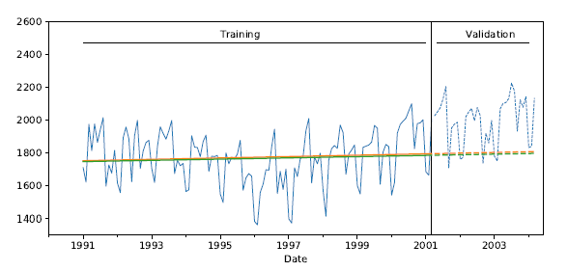
Fitting the exponential trend model, making predictions
ridership_lm_linear = sm.ols(formula='Ridership ~ trend',
data=train_df).fit()
predict_df_linear = ridership_lm_linear.predict(valid_df)
ridership_lm_expo = sm.ols(formula='np.log(Ridership) ~ trend',
data=train_df).fit()
predict_df_expo = ridership_lm_expo.predict(valid_df)
Exponential trend (green) very similar to linear trend (orange) - neither copes well with initial period of decline followed by growth period

Slide 14
Polynomial Trend
Add additional predictors as appropriate
For example, for quadratic relationship add a t² predictor
Fit linear regression using both t and t²

Slide 15
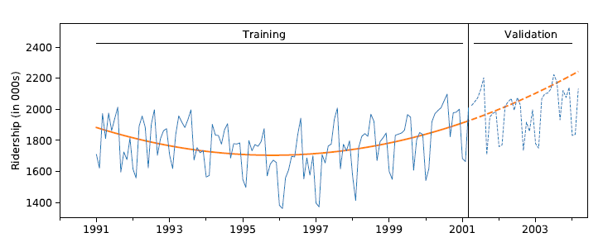
Fitting a quadratic model
ridership_lm_poly = sm.ols(formula='Ridership ~ trend +
np.square(trend)',
data=train_df).fit()
Better job capturing the trend, though it over forecasts in validation period.
Next: we’ll try capturing seasonality.

Slide 16
Handling Seasonality
Seasonality is any recurring cyclical pattern of consistently higher or lower values (daily, weekly, monthly, quarterly, etc.)
Handle in regression by adding categorical variable for season, e.g. 11 dummies for month (using all 12 would produce multicollinearity error)
Adding seasonality
ridership_df = tsatools.add_trend(ridership_ts, trend='c')
ridership_df['Month'] = ridership_df.index.month
# partition the data
train_df = ridership_df[:nTrain]
valid_df = ridership_df[nTrain:]
ridership_lm_season = sm.ols(formula='Ridership ~ C(Month)', data=train_df).fit()
ridership_lm_season.summary()

Slide 17
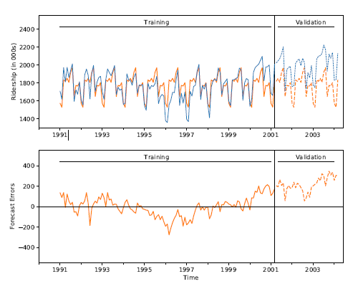
Model with Seasonality

Slide 18
Final model, Amtrak data
Incorporates quadratic trend and seasonality
13 predictors:
11 monthly dummies
t
t²
> formula = 'Ridership ~ trend + np.square(trend) + C(Month)'
> ridership_lm_trendseason = sm.ols(formula=formula,
data=train_df).fit()

Slide 19
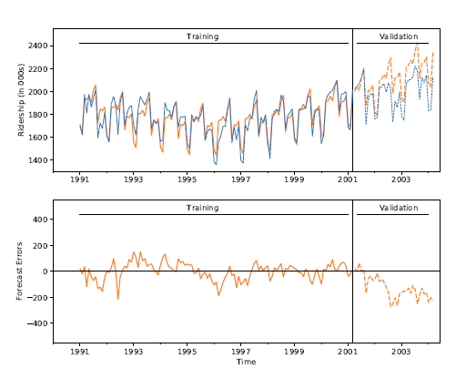
Output of full model
This model is better, though it still over-estimates in the validation period. If we are happy with the structure of this model, we can re-fit it to the entire dataset and use it to generate look-ahead forecasts.

Slide 20
Autocorrelation
Unlike cross-sectional data, time-series values are typically correlated with nearby values (“autocorrelation”)
Ordinary regression does not account for this

Slide 21
Computing autocorrelation
Create “lagged” series
Copy of the original series, offset by one or more timer periods
Compute correlation between original series and lagged series
Lag-1, lag-2, etc.

Slide 22
Amtrak – original series and Lag-1, Lag-2
Month Ridership Lag-1 Series Lag-2 Series
Jan 91 1709
Feb 91 1621 1709
Mar 91 1973 1621 1709
Apr 91 1812 1973 1621
May 91 1975 1812 1973
Jun 91 1862 1975 1812
Jul 91 1940 1862 1975
Aug 91 2013 1940 1862
Sep 91 1596 2013 1940
Oct 91 1725 1596 2013
Nov 91 1676 1725 1596
Dec 91 1814 1676 1725
Jan 92 1615 1814 1676
Feb 92 1557 1615 1814
Mar 92 1891 1557 1615
Apr 92 1956 1891 1557
May 92 1885 1956 1891
Jun 92 1623 1885 1956
Jul 92 1903 1623 1885
Aug 92 1997 1903 1623
Sep 92 1704 1997 1903
Oct 92 1810 1704 1997
Nov 92 1862 1810 1704
Dec 92 1875 1862 1810

Slide 23
Autocorrelation
Positive autocorrelation at lag-1 = stickiness
Strong autocorrelation (positive or negative) at a lag > 1 indicates seasonal (cyclical) pattern
Autocorrelation in residuals at the season lag disappears once the model incorporates seasonality

Slide 24
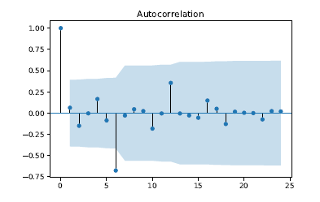
Compute & display autocorrelation for different lags, over 24 months:
tsaplots.plot_acf(train_df['1991-01-01':'1993-01-01'].Ridership)
plt.show()
blue area is 95% confidence region
Strong negative correlation at 6 months shows seasonal pattern (high summer traffic, low winter)

Slide 25
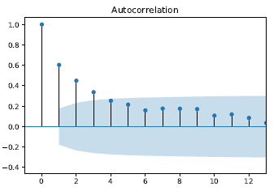
It is useful to examine autocorrelation for the residuals:
Strong autocorrelation from lag 1 on, but lag 6 no longer dominates.
Note: If you have correlation at lag 1, it will naturally propagate to lag 2, 3, etc., tapering off

Slide 26
Incorporating autocorrelation into models
Use a forecasting method to forecast k-steps ahead
Fit AR (autoregressive) model to residuals
Incorporate residual forecasts
Improved F_{t+k} = F_{t+k} + E_{t+k}

Slide 27
Choose order of the AR model
If autocorrelation exists at Lag-1, a Lag-1 model should be sufficient to capture lags at other periods as well
E_{t} = B₀ + B₁E_{t-1} + e
Where E_{t} is residual (forecast error) at time t

Slide 28
Adding ARIMA lag 1 - AR(1) - to earlier model…
formula = 'Ridership ~ trend + np.square(trend) + C(Month)'
train_lm_trendseason = sm.ols(formula=formula, data=train_df).fit()
train_res_arima = ARIMA(train_lm_trendseason.resid, order=(1, 0, 0),
freq='MS').fit(trend='nc')
forecast, _, conf_int = train_res_arima.forecast(1)
Output for April Forecast
> print(pd.DataFrame({'coef': train_res_arima.params, 'std err':
train_res_arima.bse}))
coef std err
ar.L1.y 0.599789 0.071268
> print('Forecast {0:.3f} [{1[0][0]:.3f}, {1[0][1]:.3f}]'
.format(forecast, conf_int))
Forecast 7.262 [-96.992, 111.516]
Calculating directly… (0.5998)(12.108) = 7.262
AR coefficient
March residual

Slide 29
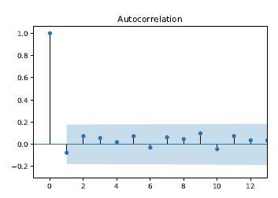
Plot autocorrelation of “residuals of residuals”
Autocorrelation is mostly gone – AR(1) has adequately captured the autocorrelation in the data:

Slide 30
Random walks
Before forecasting, consider “is the time series predictable?”
Or is it a random walk?
Do a statistical hypothesis test that slope = 1 in an AR(1) model (i.e. that the forecast for a period is the most recently-observed value)
If hypothesis cannot be rejected, series is statistically equivalent to a random walk (i.e. we have not shown that it is predictable).

Slide 31
Summary – Regression Based Forecasting
Can use linear regression for exponential models (use logs) and polynomials (exponentiation)
For seasonality, use categorical variable (make dummies)
Incorporate autocorrelation by modeling it, then using those error forecasts in the main model

